Slide 1
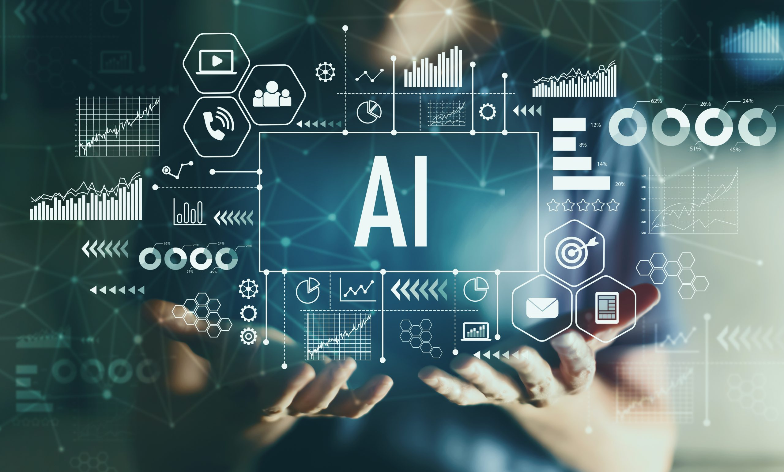
Artificial Intelligence
And Robotics

Slide 2
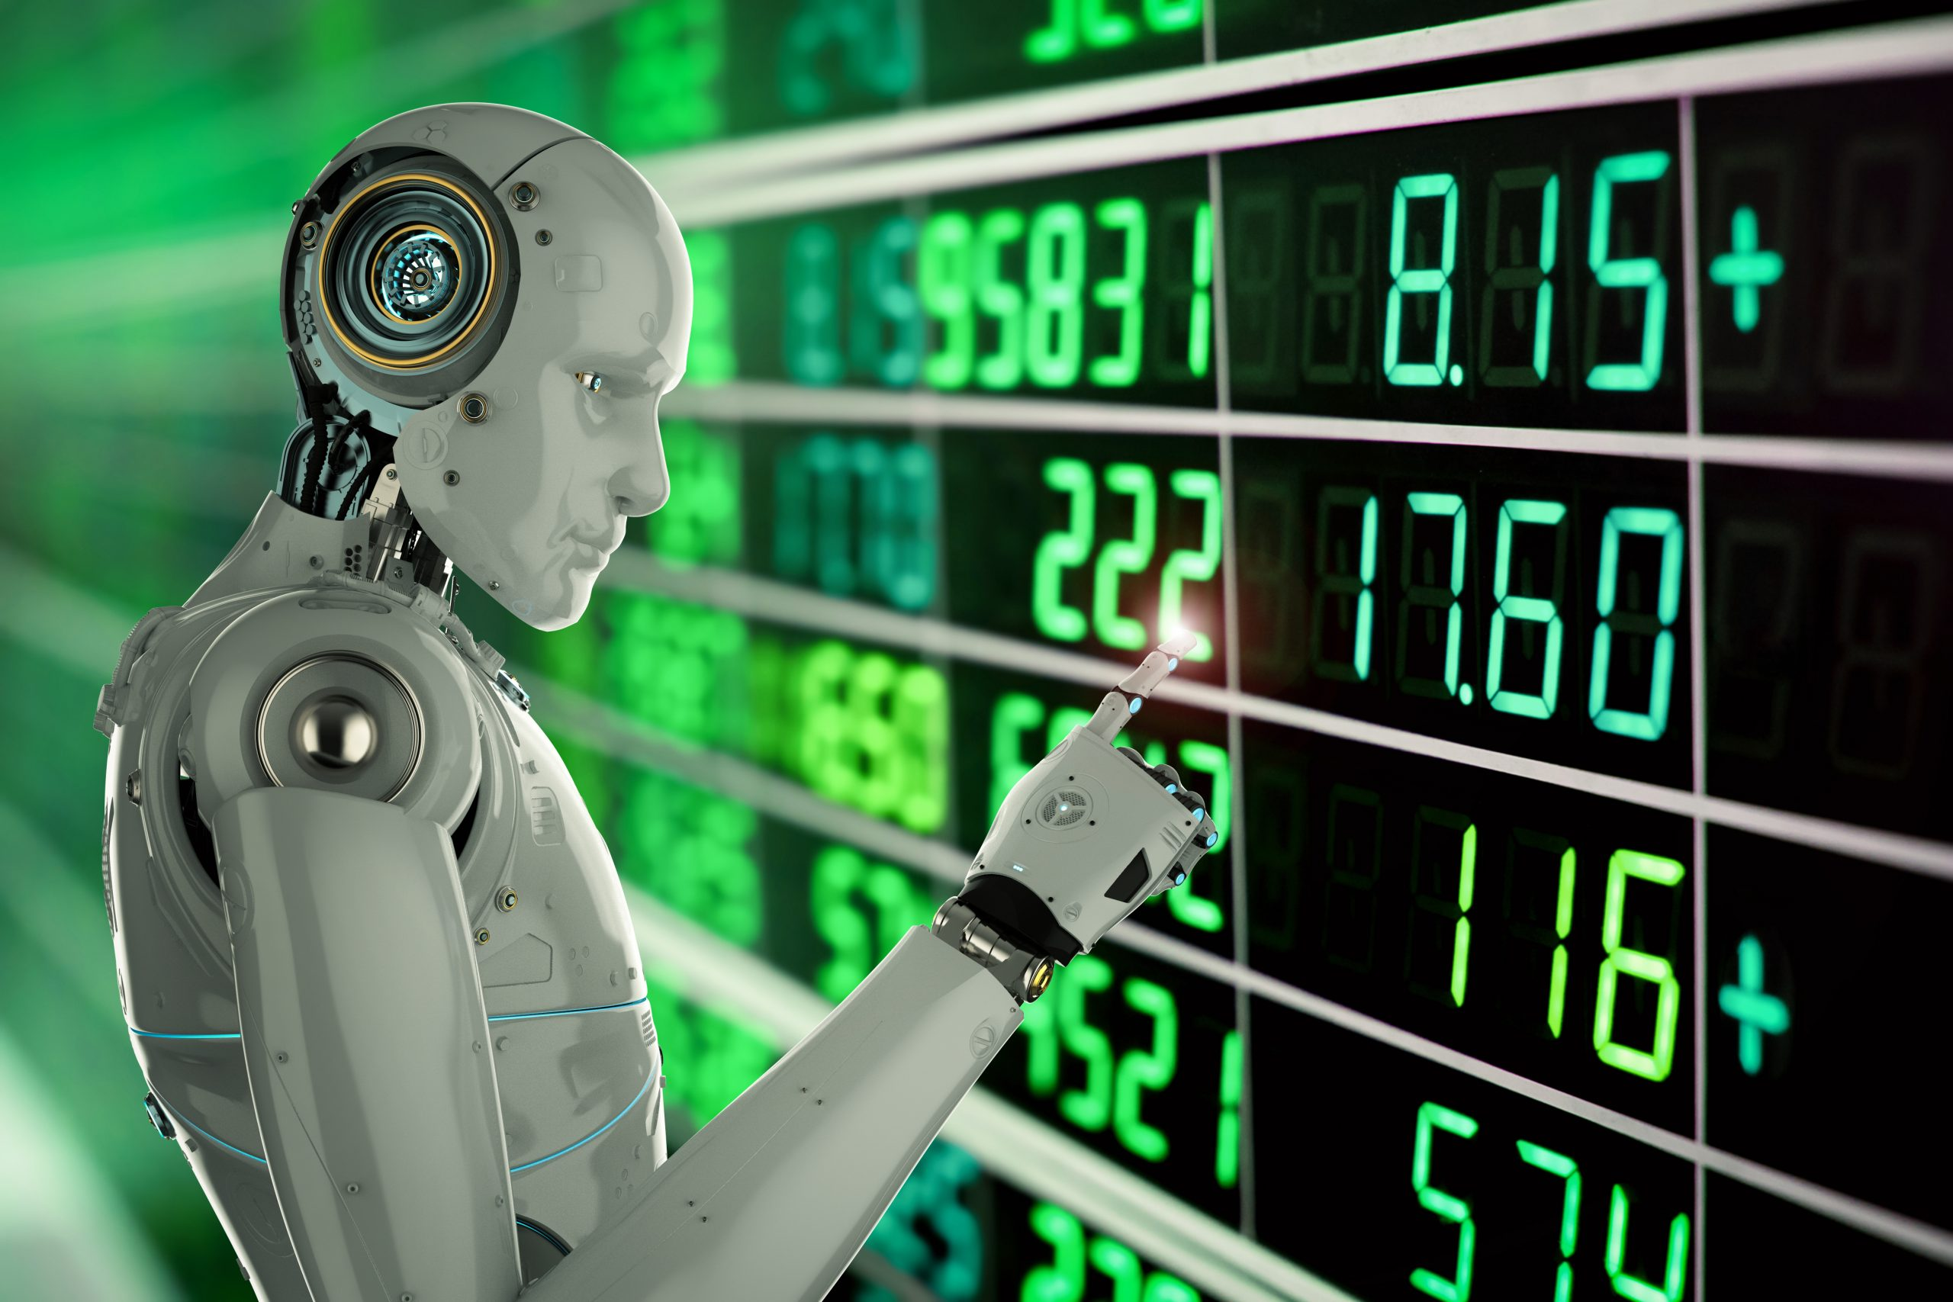
Contents
Artificial Intelligence
Introduction to AI
Components of AI
Application of AI
Advantage of AI
Disadvantage of AI
Future of AI
Robotics
Introduction to Robotics
Advantage of Robotics
Disadvantageof Robotics
Application of Robotics
Future of Robotics

Slide 3
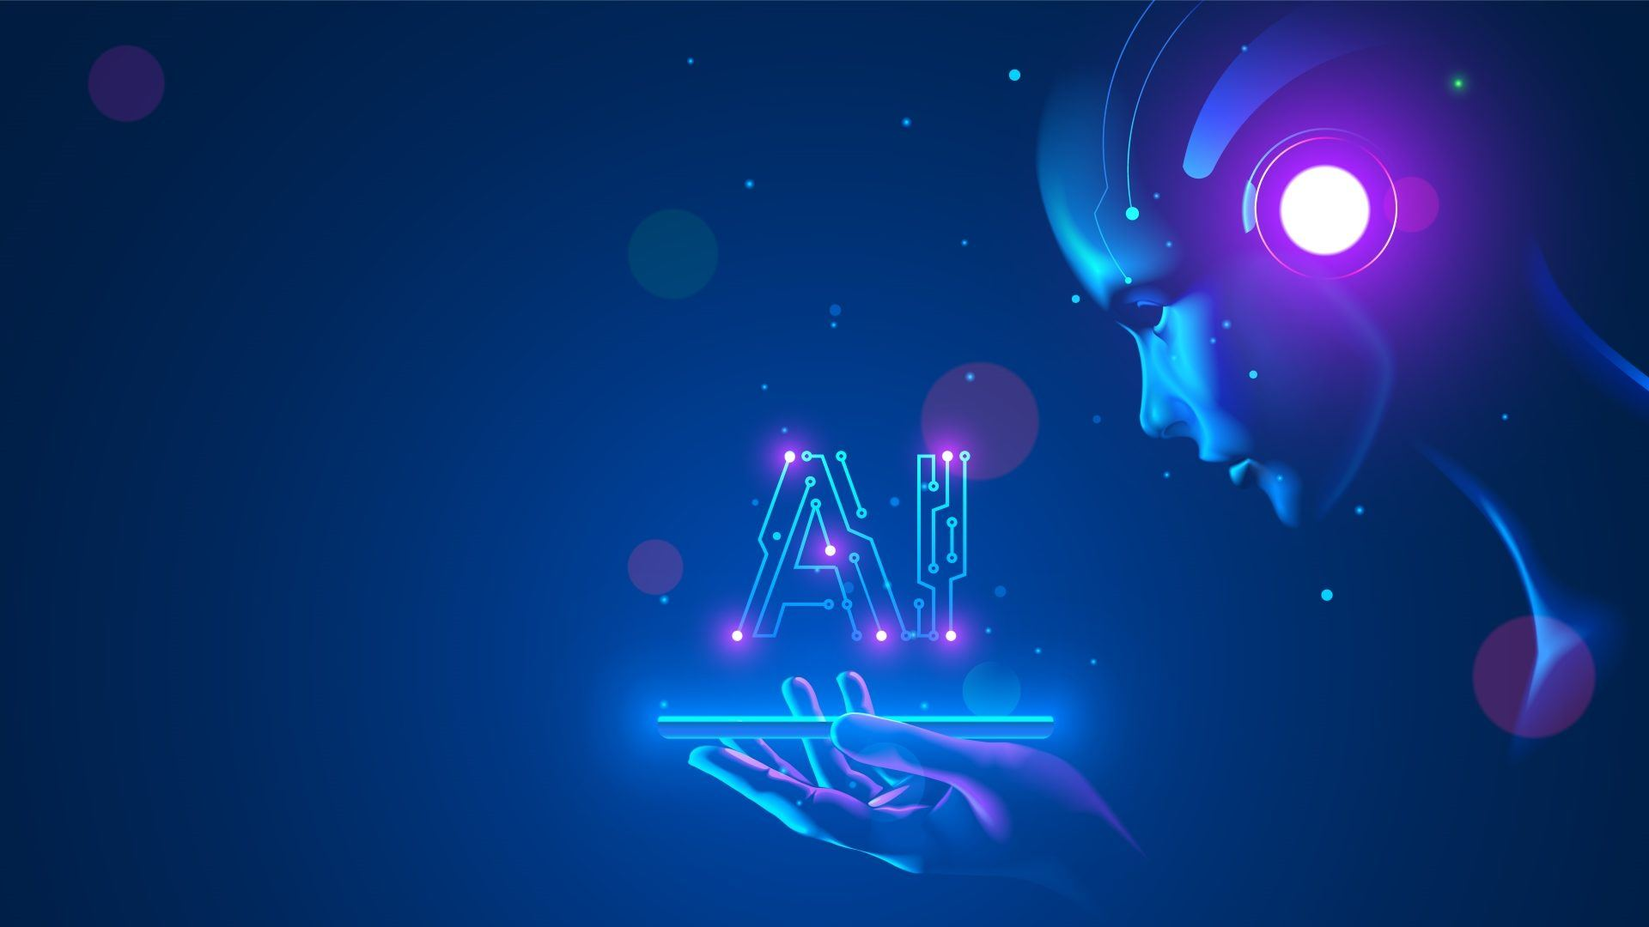

Artificial Intelligence
Introduction to AI
Artificial Intelligence (AI) means making machines capable of doing smart things that normally only humans can do. This includes learning from experience, solving problems, understanding things, and even speaking and understanding languages. The person who came up with the term AI in 1956, John McCarthy, said it's about making computer programs that can think smartly, like humans.
Programming Language for AI
Python
R
Java
C++
Julia
PROLOG
LISP

Slide 4
Artificial Intelligence
Components of AI
"Component of AI" refers to the various fundamental parts or elements that make up artificial intelligence systems.
Knowledge Representation: Storing information as data. Quality of system depends on it.
Control Strategy: Decision-making approach within AI.
Programming Language: Writing AI programs.
AI Hardware: For execution of AI program.

Slide 5
Artificial Intelligence
Application of AI
Game Playing: AI lets computers play games against humans or other computers, like chess or video games.
Speech Recognition: AI understands and transcribes human speech, used in virtual assistants and dictation apps.
Facial Recognition: AI identifies people in photos or videos, handy for security and social media tagging.
Robotics: AI enables robots to perform tasks independently, such as in factories or picking up objects.
Healthcare: AI aids doctors in diagnosing and treating patients by analyzing medical data like X-rays.
Social Media: AI suggests posts, filters content, and selects ads based on your interests on platforms like Facebook or Instagram.

Slide 6
Artificial Intelligence
Advantage of AI
Efficiency: Automation saves time and effort in task completion.
Accuracy: Processes large data sets precisely and error-free.
24/7 Operation: Operates continuously without fatigue or interruptions.
Innovation: Stimulates the development of new products, services, and business strategies.
Cost Savings: Lowers operational expenses by optimizing processes through automation.

Slide 7
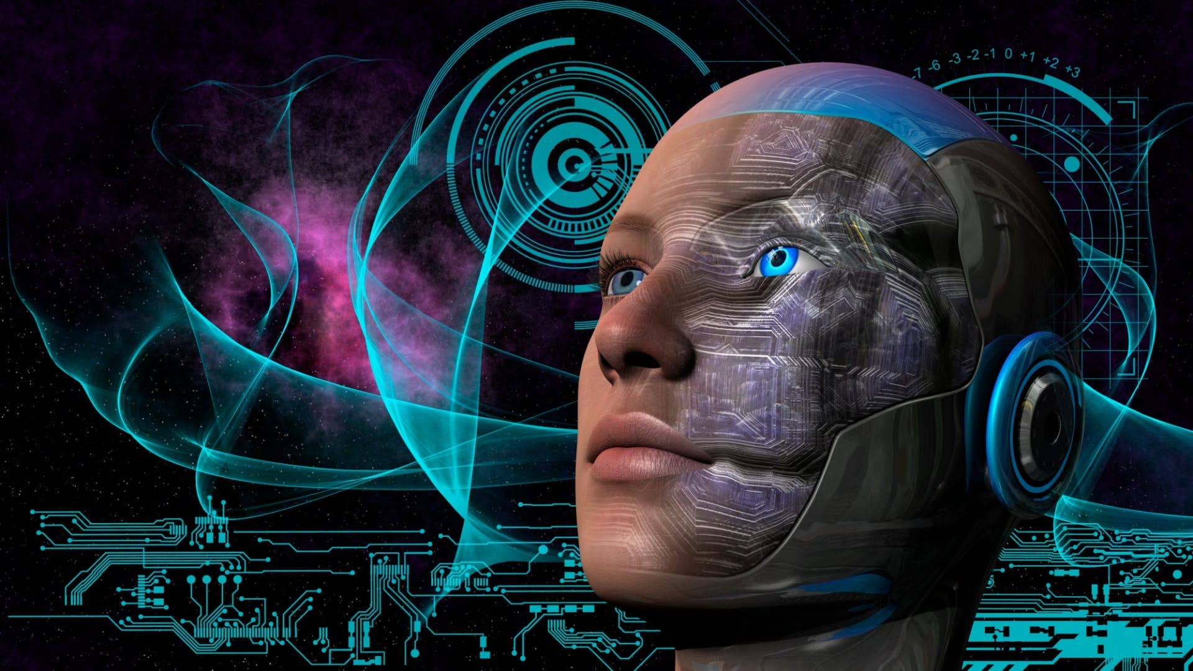
Artificial Intelligence
Disadvantage of AI
Job Displacement: Automation may lead to job loss in certain industries.
Ethical Concerns: Bias in algorithms, privacy issues, and autonomous weapons.
Dependency: Over-reliance on AI systems may lead to vulnerabilities.
Complexity: Development and maintenance of AI systems can be costly and challenging.
Lack of Creativity: AI lacks human-like creativity and intuition in problem-solving.

Slide 8

Artificial Intelligence
Future of AI
Advancements in Deep Learning: Further breakthroughs in neural networks and deep learning algorithms.
Ethical AI: Greater emphasis on developing AI systems that prioritize ethics and fairness.
Human-AI Collaboration: Enhanced collaboration between humans and AI in various domains.
AI in Edge Computing: Integration of AI capabilities into edge devices for real-time processing.
AI Regulation: Increased focus on regulating AI to ensure safety and accountability.

Slide 9
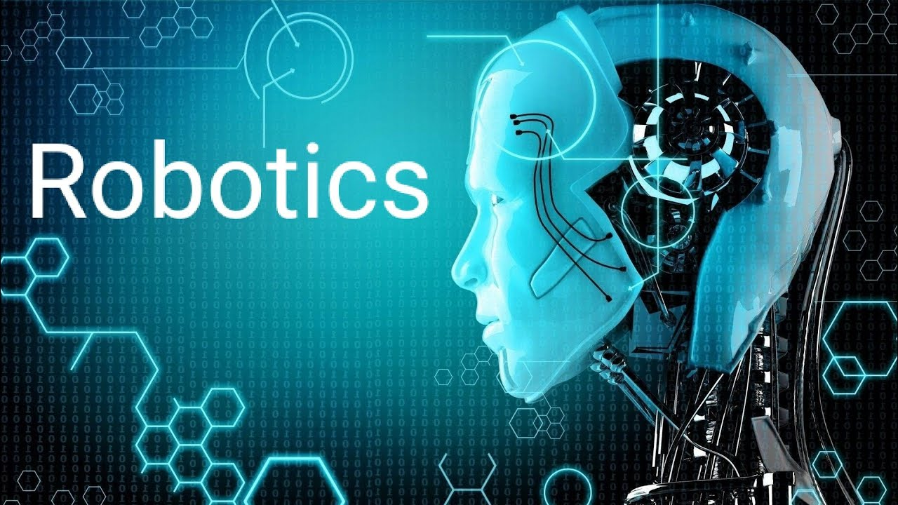

Slide 10
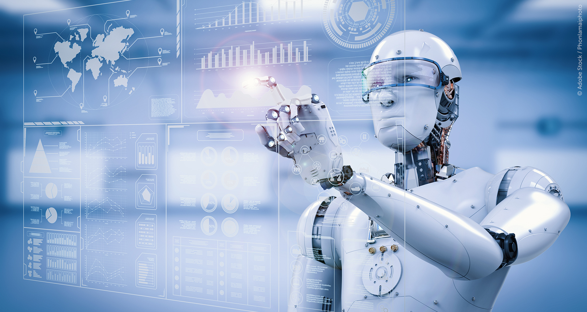
Robotics
Introduction to Robotics
"Robotics is about making robots - machines that can do different jobs by themselves. It's a mix of engineering and science where people build, control, and use robots in different places like factories, hospitals, or even in space."

Slide 11
Robotics
Advantage of Robotics
Precision and Accuracy: Robots do tasks very accurately, improving quality.
Increased Efficiency: Robots save time and money by doing repetitive tasks fast.
Safety: Robots do dangerous jobs, keeping people safe.
24/7 Operation: Robots work non-stop, boosting production.
Versatility: Robots can be used in many different ways for different jobs.

Slide 12
Robotics
Disadvantage of Robotics
Initial Cost: Getting robots set up is expensive, including buying, installing, and training.
Complexity: Making and maintaining robots is hard and needs special skills.
Job Displacement: Robots taking over jobs can lead to people losing work, especially in manual labor.
Limited Flexibility: Robots struggle with changes and surprises compared to humans, especially in messy places.
Ethical Concerns: People worry about robots being used in ways that might be harmful or invade privacy.

Slide 13
Robotics
Application of Robotics
Manufacturing: Robots build cars, electronics, and airplanes in factories.
Healthcare: Robots assist in surgeries and provide medical help remotely.
Agriculture: Robots plant, harvest, and monitor crops on farms.
Logistics and Warehousing: Robots move goods and pack them in warehouses.
Space Exploration: Robots explore other planets and gather data for scientists.

Slide 14
Robotics
Future of Robotics
AI Integration: Robots are getting smarter with technologies like machine learning and computer vision.
Collaborative Robotics: Robots are working alongside humans more safely and efficiently.
Autonomous Navigation: Robots are learning to move by themselves in complex environments.
Soft Robotics: New robots are flexible and adaptable like living creatures.
Humanoid Robots: Robots that look like humans are improving and being used in various industries.

Slide 15

ANY QUESTION ?

Slide 16
